Slide 1
TOPIC:-SALES PREDICTIONS
TEAM NAME:- BYTE CODE
MEMBERS
TUSARJYOTI DAS
SOURADEEP PAUL
DEEP DAS
SOHAM SAHA
NILADRI DHAR

Slide 2

INTRODUCTION
A company may better control the cost of a product's production and marketing by predicting its future sales. Predicting the future sales of a product has several other advantages. so we have developed this model to understand how to use machine learning to anticipate future product sales. I'll walk you through the process of using Python to estimate future sales using machine learning in this post.

Slide 3

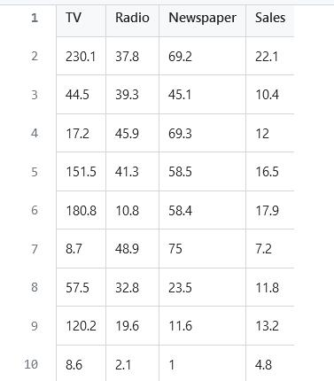
SOURCE OF DATA
GitHub - Souradeeppaul17/data_source

Slide 4

Data Analytics software used
Python & Jupyter Notebook Libraries used:
● Numpy- solve complex mathematical problems.
● Pandas-use for dataframe manipulation.
● plotly-to create data visualization.
● Matplotlib- to create data visualization.
● sklearn- Implement complex machine learning algorithm.
Machine Learning Algorithms used:
● Clustering Analysis. ● Logistic Regression

Slide 5
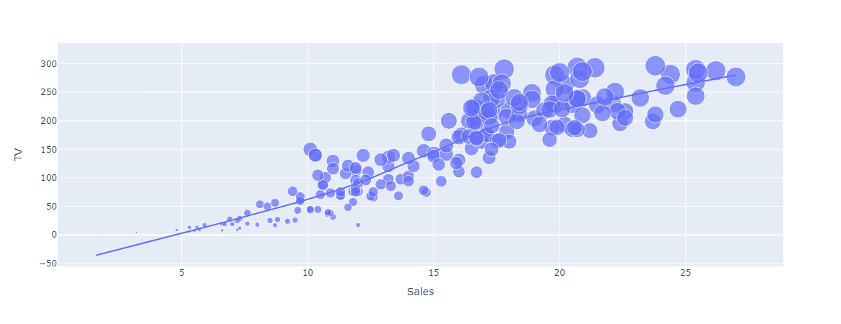
GRAPH ANALYSIS
GRAPH FOR TV SALES:-

Slide 6
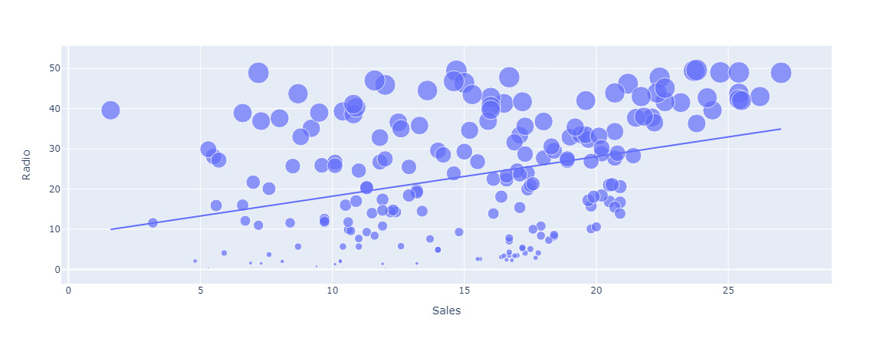
GRAPH FOR RADIO SALES:-

Slide 7
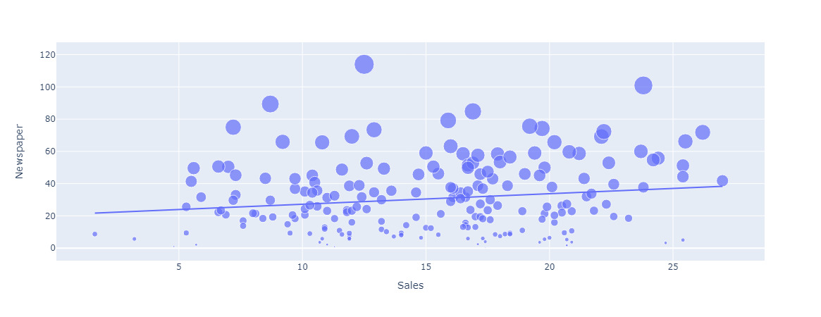
GRAPH FOR NEWSPAPER SALES:-

Slide 8

DATA PREPROCESSING AND MODELING
Clean the data by handling missing values, outliers, and inconsistencies. Explore the relationships between variables through statistical analysis and visualizations. Split the dataset into training and testing sets to evaluate the model's performance accurately.
Model Selection: Choose an appropriate machine learning algorithm for sales prediction, such as linear regression, decision trees. Consider the strengths and limitations of each algorithm and select the one that best suits the problem and the available data

Slide 9
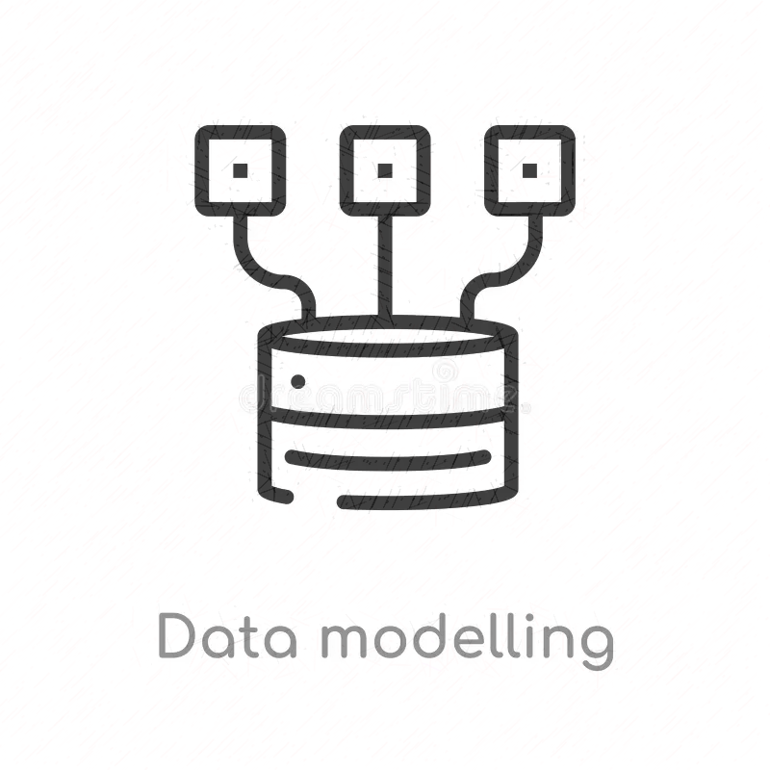
DATA PREPROCESSING AND MODELING
Model Training and Evaluation: Split the training set further into a smaller training set and a validation set to evaluate and tune the model during training. Train the selected model on the training set using the chosen algorithm.
Model Deployment and Prediction: Once the model is finalized, retrain it using the entire training dataset. Evaluate the model's performance on the testing set, using the same metrics used during validation. Use the trained model to make predictions on new data, i.e., future sales, based on the advertising expenditure for radio, newspaper, and TV.

Slide 10

PROBABLE OUTCOME
The outcome of developing a model for predicting sales for radio, newspaper, and TV is to have a reliable and accurate prediction system that can estimate the expenditures for sales on each channel. This model can provide valuable insights, allowing businesses to optimize their resource allocation and make informed decisions to manufacture optimum number of units

Slide 11





TEAM MEMBERS:-
Tusarjyoti Das
Niladri Dhar
Souradeep Paul
Deep Das
Soham Saha

Slide 12


